Slide 1
Croatia

Slide 2
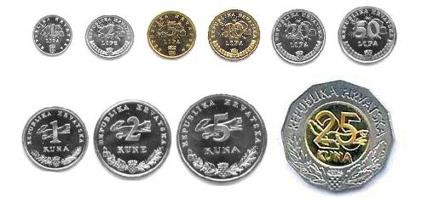
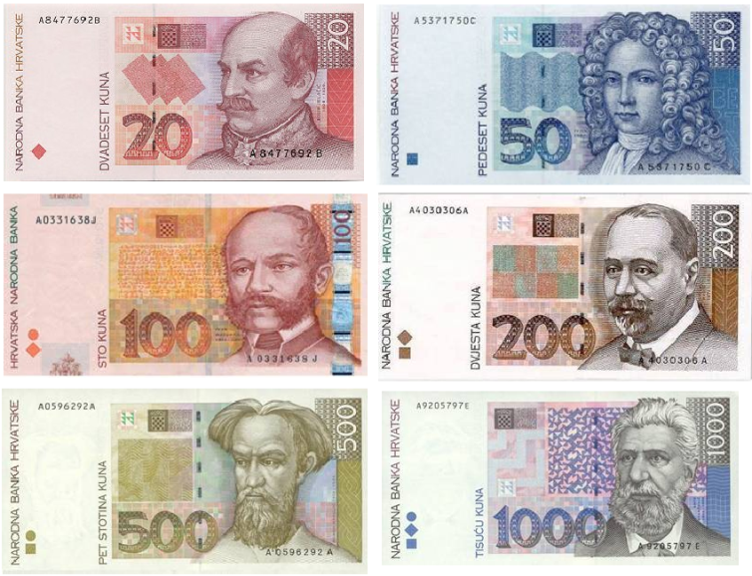
Little bit about croatia
Capital city- Zagreb
Area-56 594 km²
Population- 4 284 889
Currency- Kuna
President: Kolinda Grabar-Kitarović

Slide 3
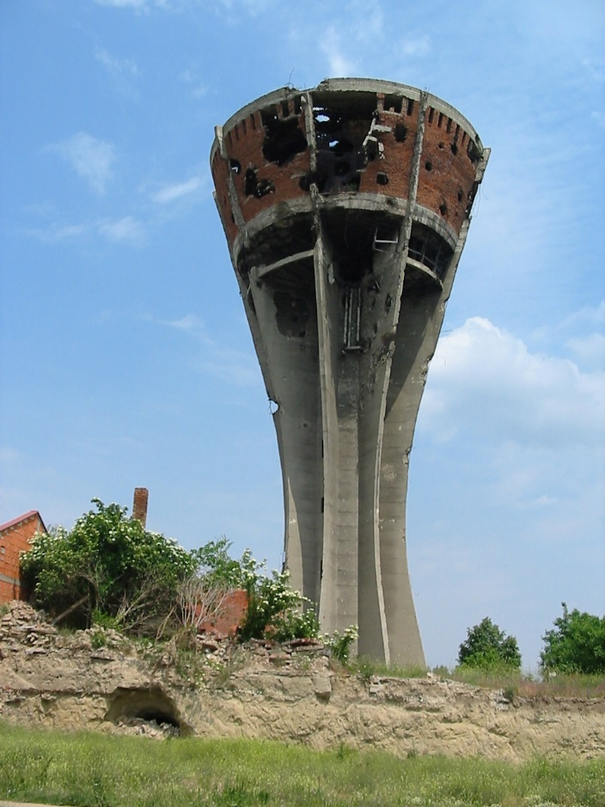
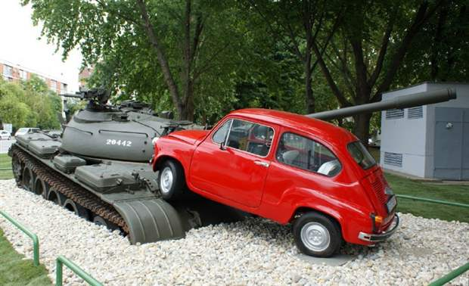
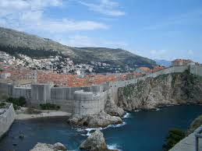
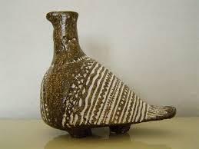
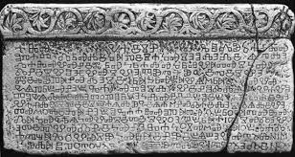
monuments

Slide 4
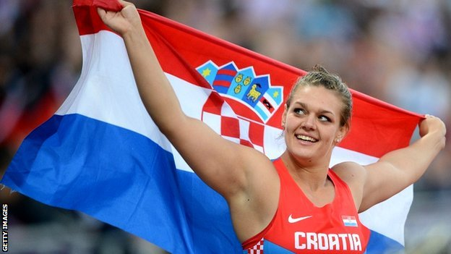
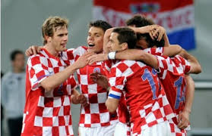
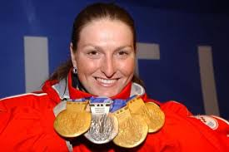
SPORT
SKIING
HIGH JUMP
DISCUS THROW
FOOTBALL
HANDBALL
TENNIS

Slide 5
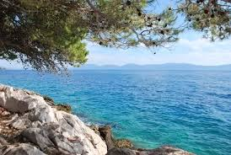
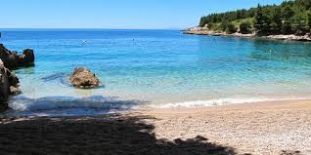
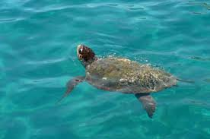
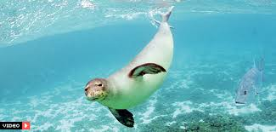
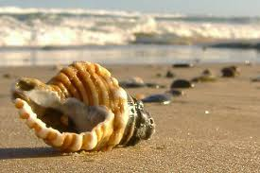
Adriatic sea
Surface area -138.600 km²
Max. Depth - 1,233 m
The sea is warm, in summer sea temperature is pleasant for swimming, which, along with its beauty is essential to the development of tourism

Slide 6
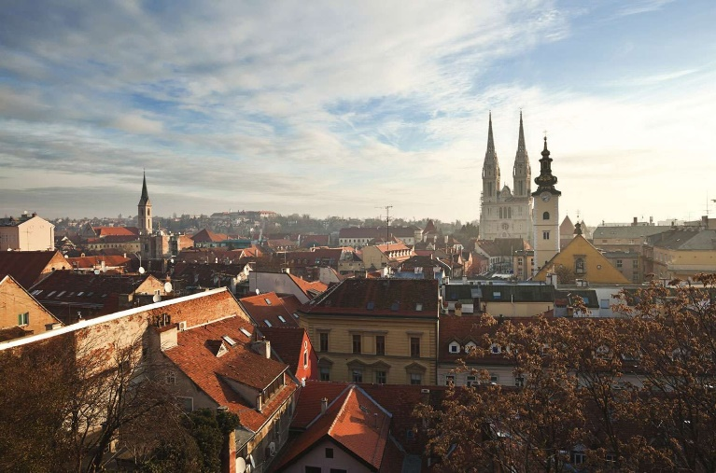
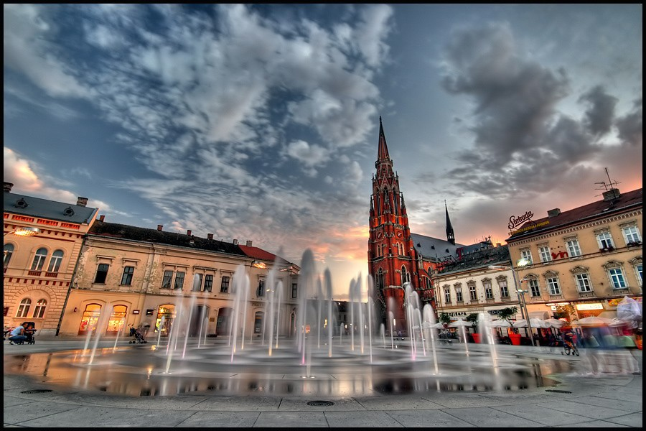
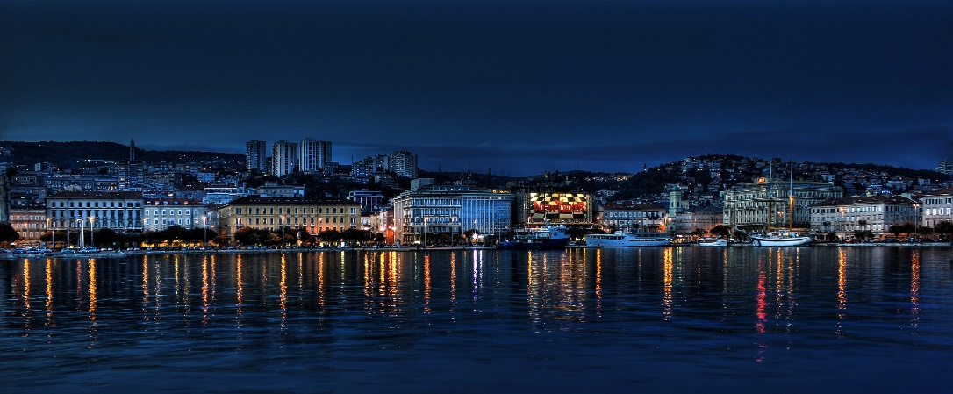
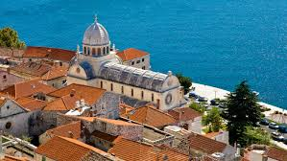
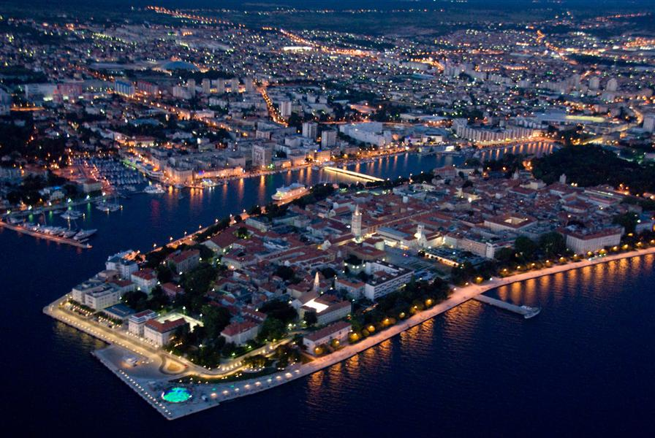
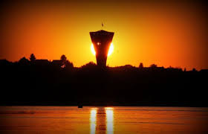
SOME CITIES
ZAGREB(CAPITAL CITY)
OSIJEK
SPLIT
DUBROVNIK
ŠIBENIK
ZADAR
RIJEKA
VUKOVAR

Slide 7
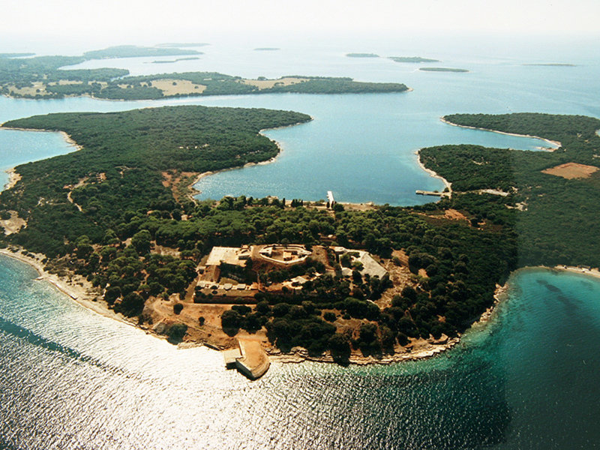
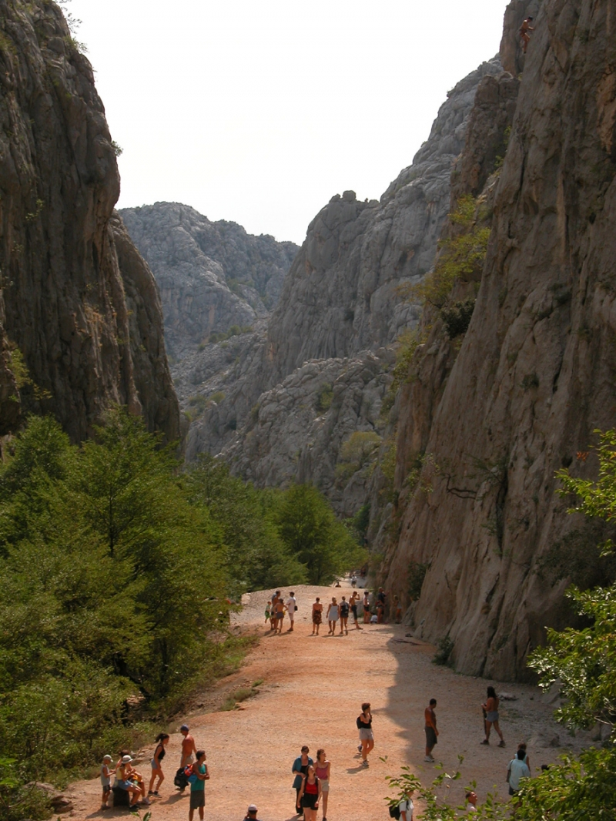
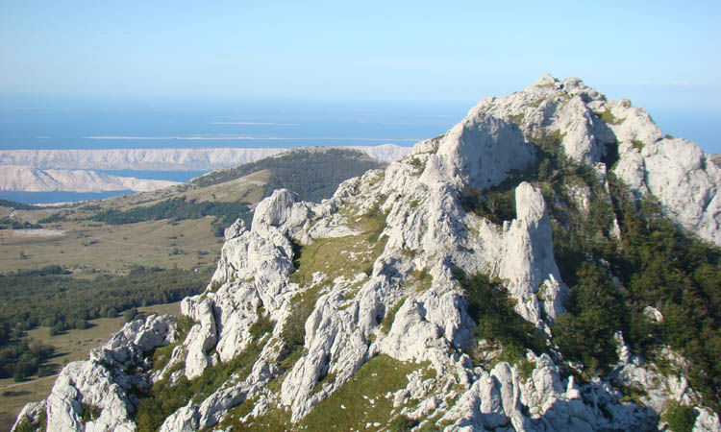
NATIONAL PARKS
Brijuni
Kornati
Krka
Mljet
Paklenica
Plitvice lakes
Risnjak
Sjeverni Velebit

Slide 8
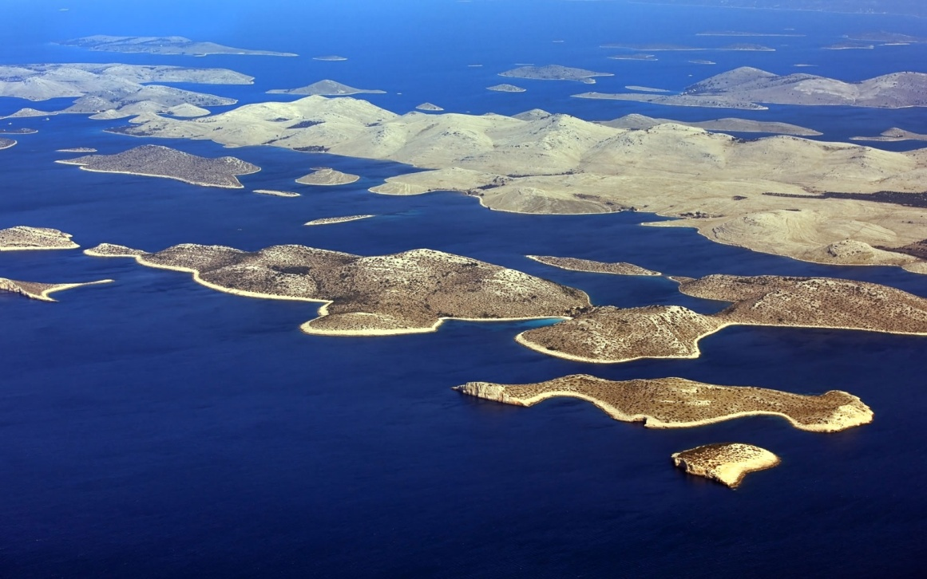
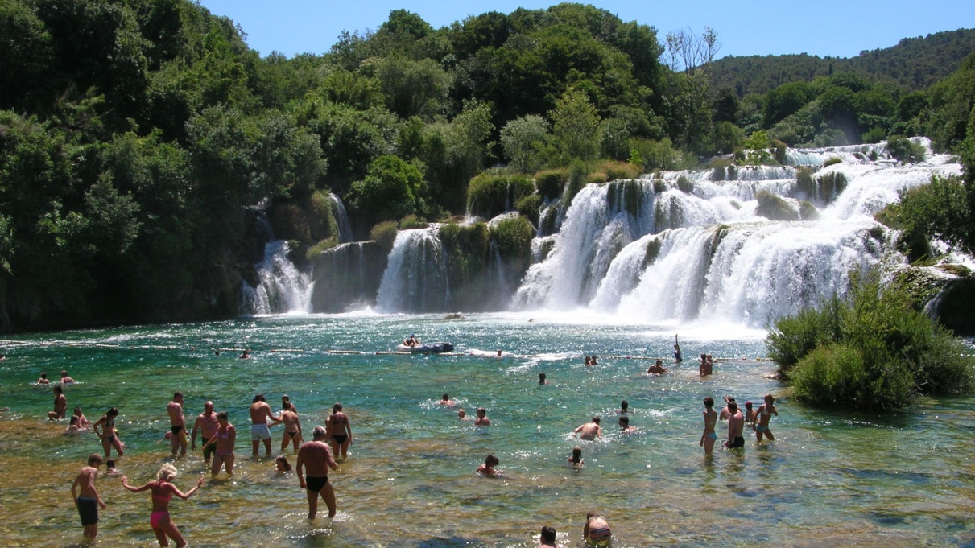
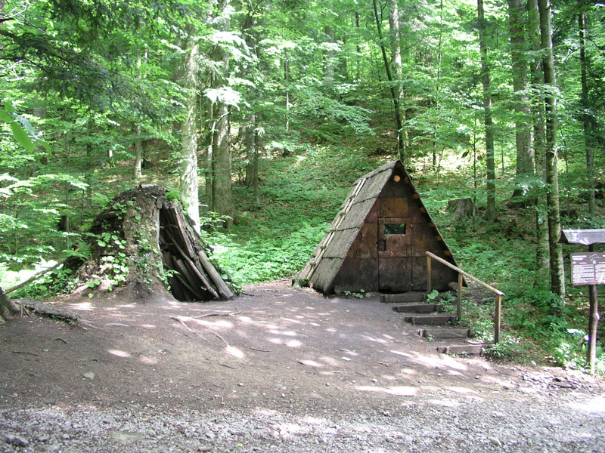
Kornati
Krka
Risnjak

Slide 9
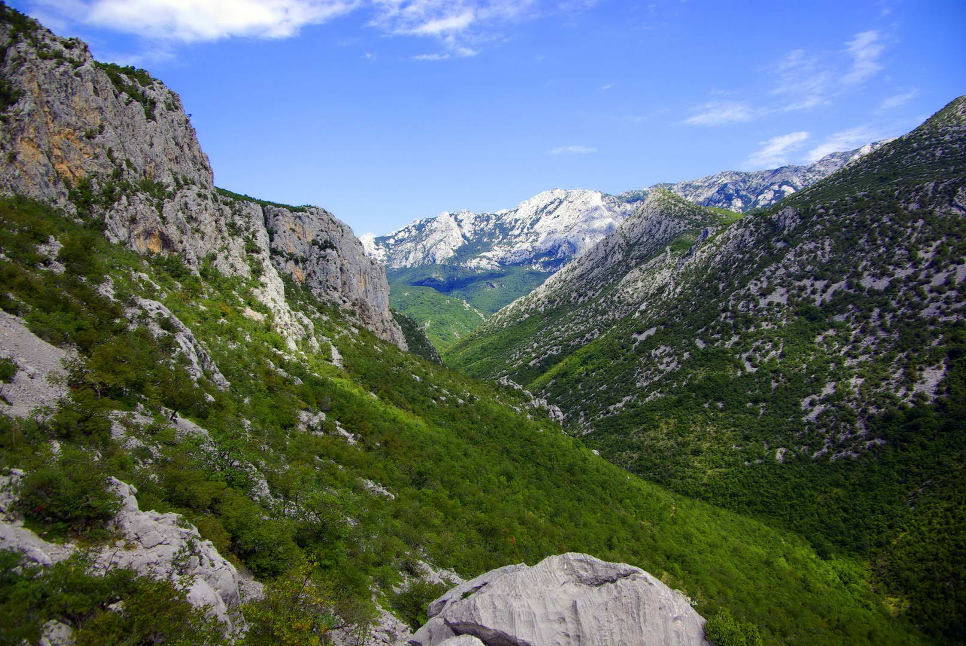
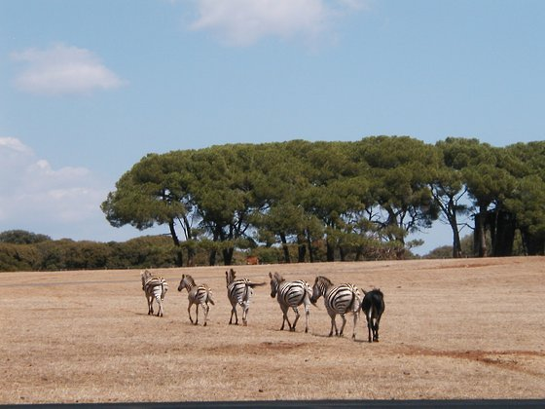
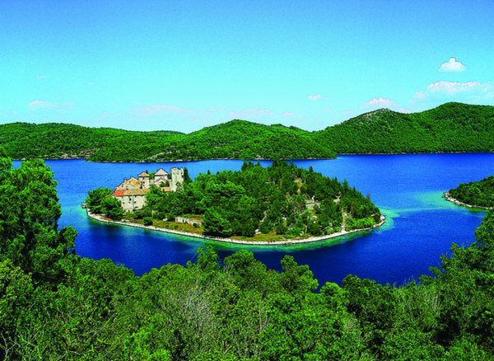
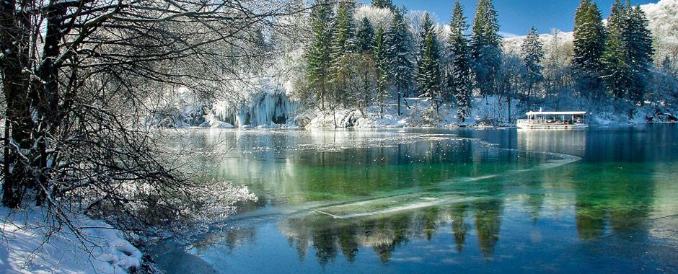
Paklenica
Brijuni
Plitvice lakes
(at winter)
Mljet

Slide 10
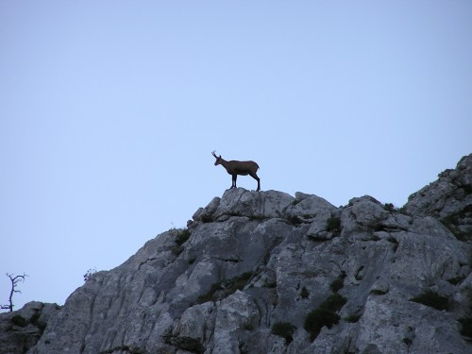
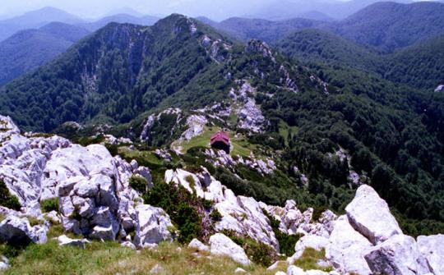
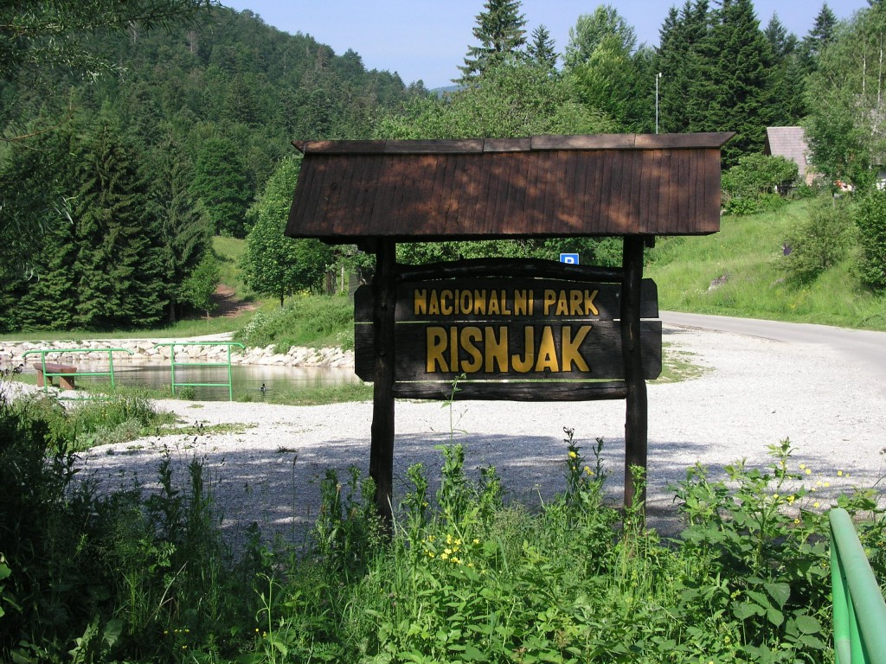
Sjeverni Velebit
Risnjak
Krka

Slide 11
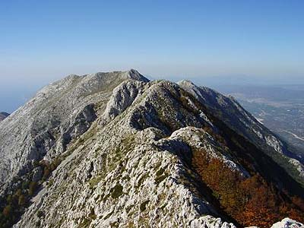
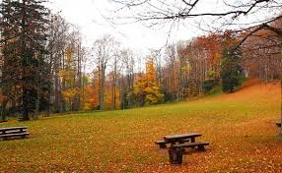
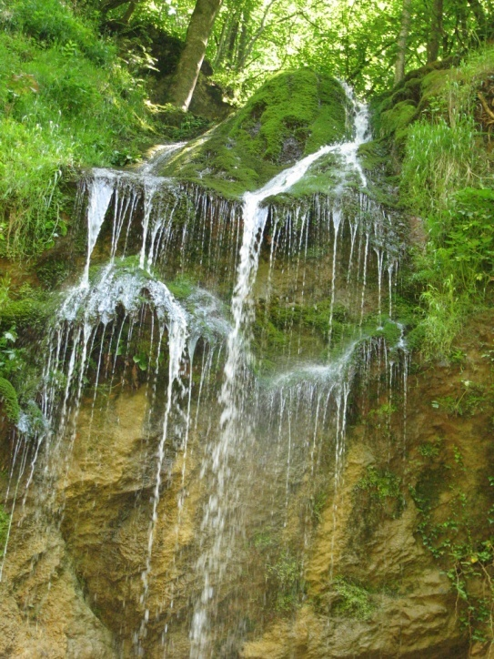
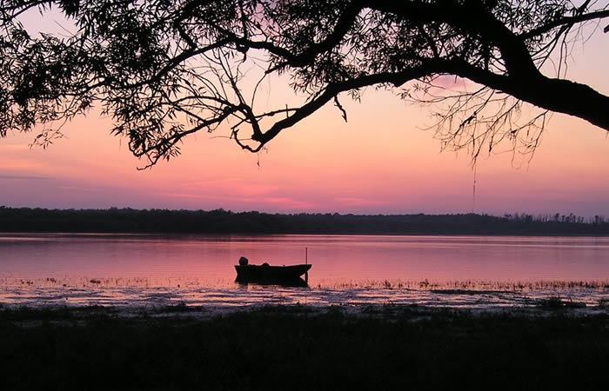
Nature parks
Nature park Biokovo
Nature park Kopački rit
Nature park Lonjsko polje
Nature park Medvednica
Nature park Papuk
Nature park Telašćica
Nature park Velebit
Nature park Vransko jezero
Nature park Učka
Nature park Žumberak
Nature park Lastovsko otočje

Slide 12
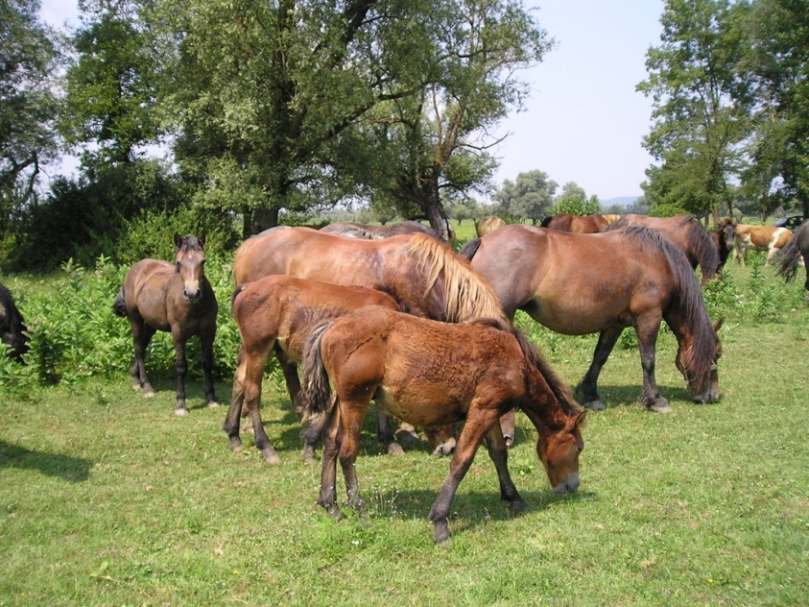
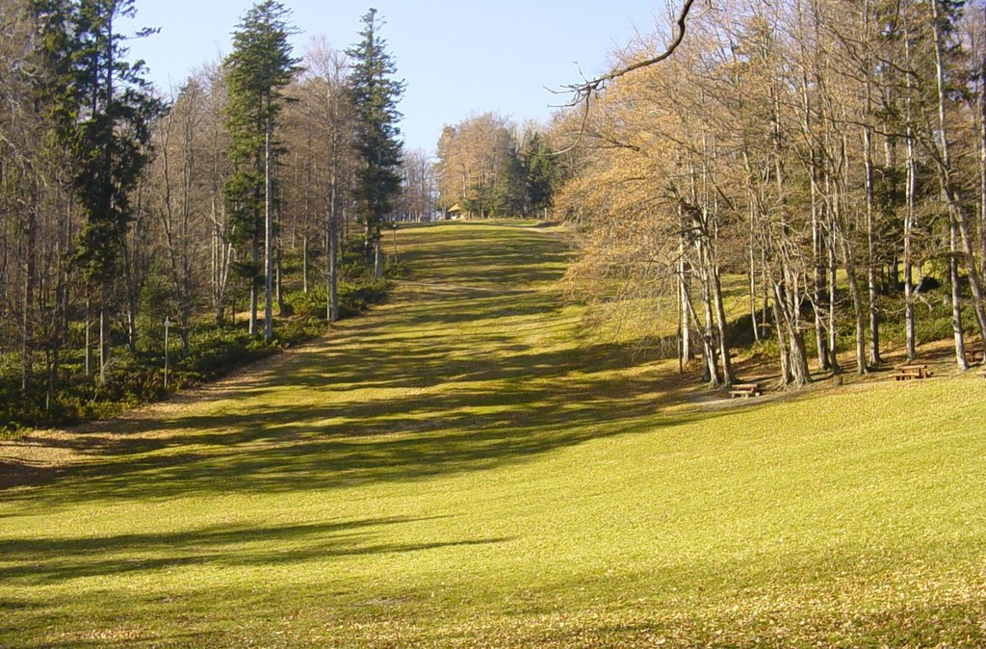
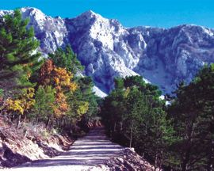
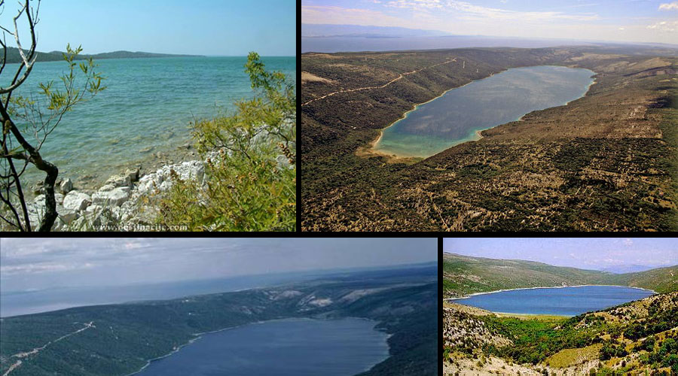
Pictures of thease nature parks
Medvednica
Lonjsko polje
Biokovo
Vransko jezero

Slide 13
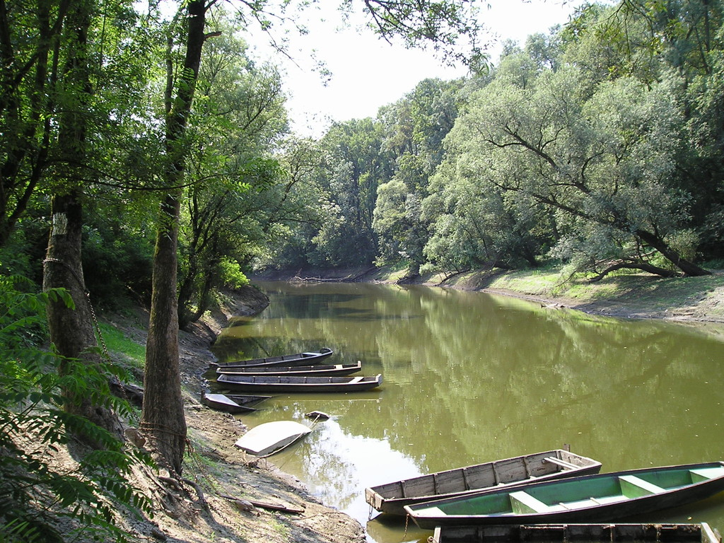
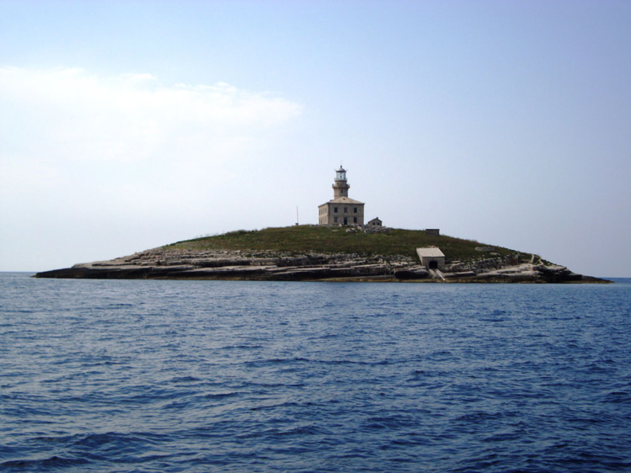
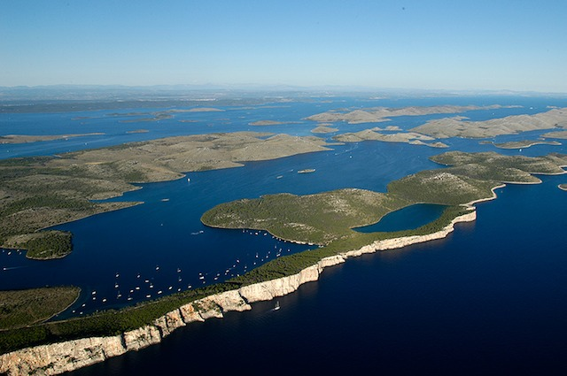
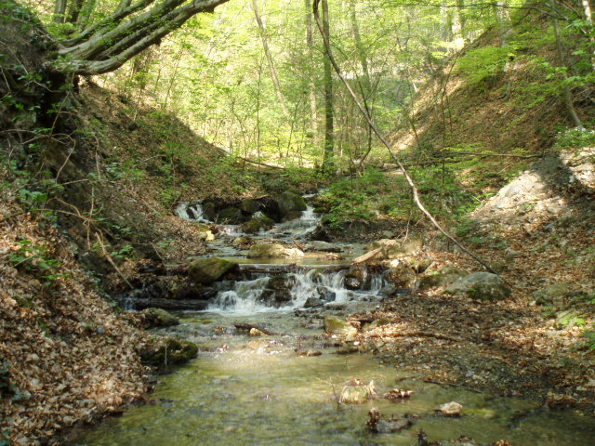
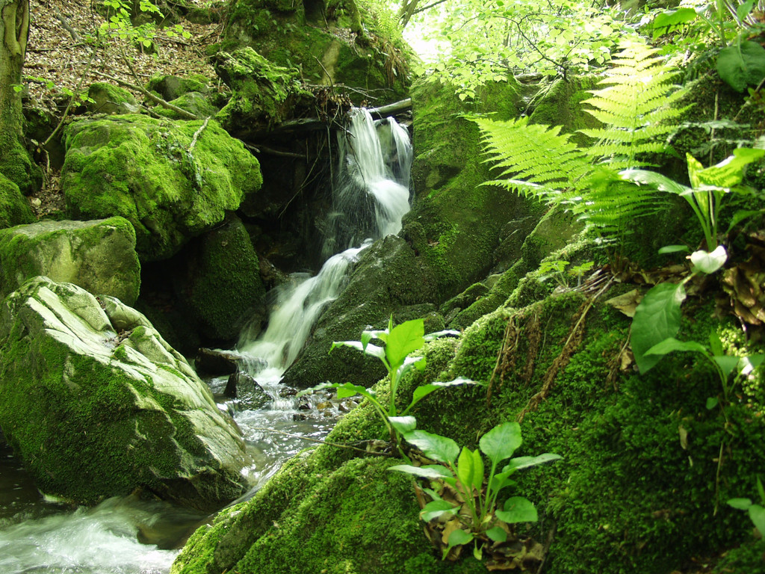
Lonjsko polje
Lastovsko otočje
Medvednica
Telašćica
Papuk

Slide 14
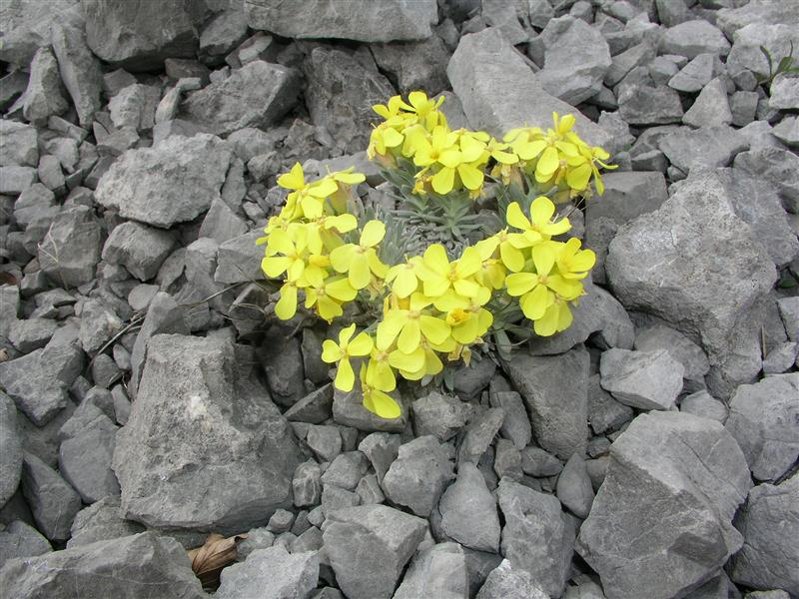
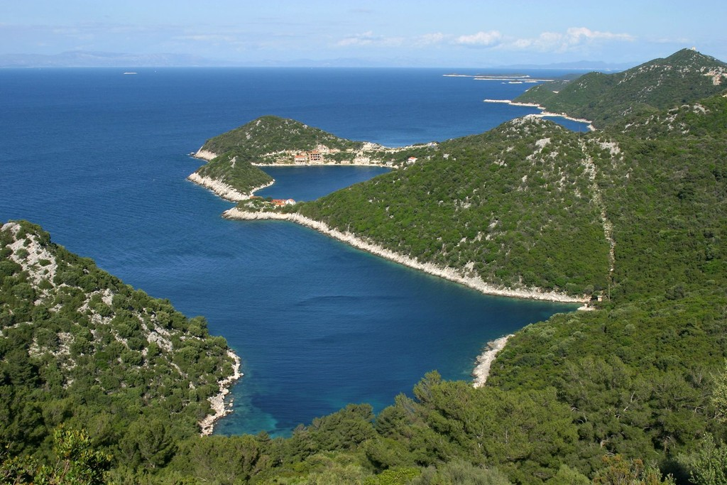
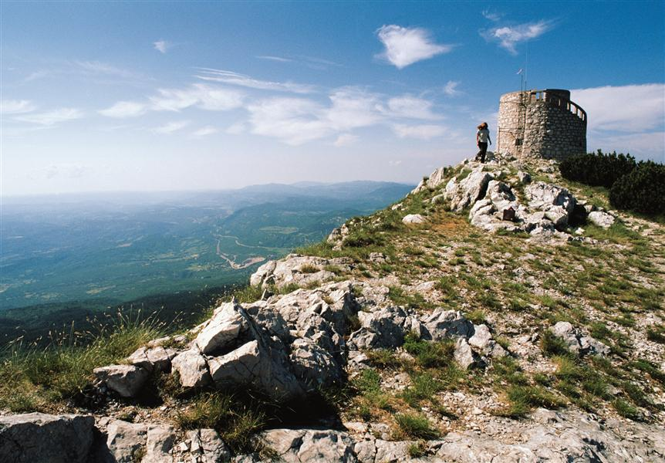
“Velebitska degenija” - The yellow-flowered plant is endemic to Velebit and Kapela mountain ranges, and has become a symbol of the region.
Papuk
Učka
Lastovsko otočje

Slide 15
About us
We are from Osijek-Baranja County
Two rivers go through Baranja-
Drava and Dunav
We have natural park Kopački rit
Kopački rit

Slide 16
Dunav and drava

Slide 17
Croatian cuisine
“Zagorski Štrukli”
Goulash is very popular
in most parts of Croatia
White Truffles from Istria
Savijača or Štrudla with apple

Slide 18
Kopački rit
There are around 260 various bird species nest here and there are many other species using this area as a temporary shelter
There are 40-odd fish species (pike, ide, tench , bream, carp,
catfish, pike-perch, perch, etc.)
Several various mammal species inhabit the land (red deer,
roe deer, wild boar, wild cat, pine marten, stone marten,
weasel, sable, otter, etc.).

Slide 19
Kopački rit

Slide 20
Kopački rit

Slide 21
Thank you for your attention

